Slide 1
Take Home Lab 5
Munchie Monkey

Slide 2
Question
Monkey likes to swing from tree to tree. They can swing from one tree to another directly as long as there is no tree in between that is taller than or have the same height as either one of the two trees.

Slide 3
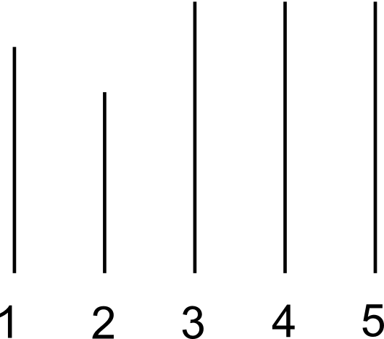
Questions
For example, if there are 5 trees with heights 19m, 17m, 20m, 20m and 20m lining up in that order:

Slide 4
Questions
For example, if there are 5 trees with heights 19m, 17m, 20m, 20m and 20m lining up in that order:

Slide 5
Questions
For example, if there are 5 trees with heights 19m, 17m, 20m, 20m and 20m lining up in that order:

Slide 6
Questions
For example, if there are 5 trees with heights 19m, 17m, 20m, 20m and 20m lining up in that order:

Slide 7
Questions
For example, if there are 5 trees with heights 19m, 17m, 20m, 20m and 20m lining up in that order:

Slide 8
Questions
For example, if there are 5 trees with heights 19m, 17m, 20m, 20m and 20m lining up in that order:

Slide 9
Questions
There are 5 pairs of trees that the monkey can swing directly from one to the other

Slide 10
Questions
Task: given the heights of the trees,
count the number of pairs of trees that the monkey can swing directly from one to the other

Slide 11
Input
The first line contains N, the number of trees in the path.
The next line contains N integers a₁ a₂ a₃ … a_{n} where a_{i} represents the height of the i_{th} tree in the path.
0<= ai <= 2^31
2<=N<=500000

Slide 12
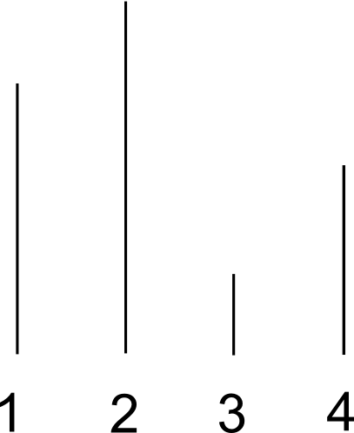
Example
Input
4
3 4 1 2
Output
4

Slide 13
Algorithm
Algorithm #1: Try all pairs of tree (i, j) and check if the monkey can swing from i to j:
bool canSwing(int i, int j)
  for (int k=i+1; k<=j-1; ++k)
  if (height[k] >= min(height[i], height[j]))
  return false;
  return true;

Slide 14
Algorithm
Algorithm #1: Complexity: Cubic O(N³). Too slow for N = 500,000

Slide 15
Algorithm
More efficient algorithm:
Observation: From a tree before tree i and not taller than tree i, the monkey cannot reach any tree after i
i

Slide 16
Algorithm
Thus, after we process tree i, we can forget all the trees before it and not taller than it
i

Slide 17
Algorithm
The trees we still keep track of will be in deceasing order of the height. Why?
i

Slide 18
Algorithm
Suppose it's not in decreasing order:
i

Slide 19
Algorithm
When we process the green tree, we have already remove the purple one:
i

Slide 20
Algorithm
Now when we process tree i+1, we know how many trees that can reach it:
i
i+1

Slide 21
Algorithm
Then we repeat the process, remove some trees:
i
i+1

Slide 22
Algorithm
Hint: use a stack data structure for the above algorithm:
Remove a tree: pop from the stack
Insert a new tree: push to the stack
i
i+1

